Slide 1
Improving TSP Tour using Dynamic Programming
Team G2

Slide 2
Intro
Given a graph, the problem is to find the shortest possible route that visits every vertex exactly once and returns to the starting point.

Slide 3
First point - Two Approach
Naive Solution:
1) Consider city 1 as the starting and ending point.
2) Generate all (n-1)! Permutation of cities.
3) Calculate cost of every permutation and keep track of minimum cost permutation.
4) Return the permutation with minimum cost.
Dynamic Solution:
Dynamic Programming is a method of solving problems by breaking the solution into a set of steps or stages so that the solution of the problem can be viewed from a series of interrelated decisions
Series of optimal decisions.
Uses recursive approach.

Slide 4
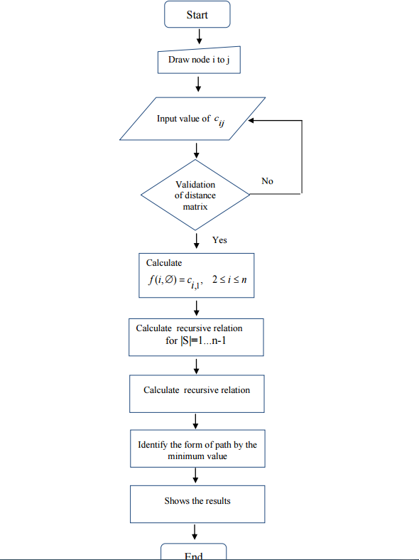
Second point - Algorithm to solve
If size of S is 2, then S must be {1, i},
C(S, i) = dist(1, i)
Else if size of S is greater than 2.
C(S, i) = min { C(S-{i}, j) + dis(j, i)} where j belongs to S, j != i and j != 1.

Slide 5

Final point - Algorithm Complexity
Naive Approach - O(n!)
Dynamic Approach
Our code - O(n² 2^{n})
can achieve upto O((n^{(1/4+ǫk)k})*
* Read this : https://arxiv.org/pdf/1703.05559.pdf

Slide 6
Conclusion Dynamic solution reduces complexities and provide efficient solution.

Slide 7

Thanks!

